Slide 1
Is it Orientation, or is it Onboarding?
Penny Fletcher, PHR, SHRM-CP
Wyo SHRM Workforce Readiness Chair
HR Manager, Little America Hotel Cheyenne

Slide 2
Before we can onboard, we need to hire!
How soon do you call after you get a resume/application?
Who is part of the interview process?
How do you communicate with HR and other impacted staff
What is the new hire timeline?

Slide 3
? ? ? Around the Room ? ? ?
What do you think onboarding is, and what is one thing you think you do very well when onboarding?

Slide 4
Orientation vs Onboarding
Procedures/Policies
Chain of command
Specific Task Training
“Who’s Who”
Benefits and other paperwork
Access to computers, etc
One time
Forming relationships
Performance expectations
Company Culture
Mission
Vision
Values
Ongoing

Slide 5
Condensed Employee Orientation

Slide 6
Orientation Topics Covered
General Standards of Conduct
Little America Service Standards
Health and Safety
Benefits
Departmental policies/procedures
Questions

Slide 7
Sexual Harassment Policy
The company policy, in compliance with Federal law, prohibits
Unwelcome sexual advances
Requests for sexual favors
Other verbal or physical conduct of a sexual nature made to an employee
Any complaints involving sexual harassment will be taken seriously and investigated promptly.

Slide 8
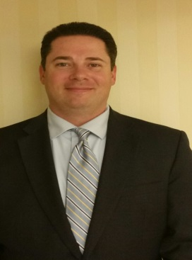
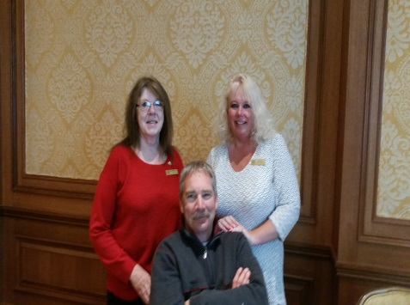
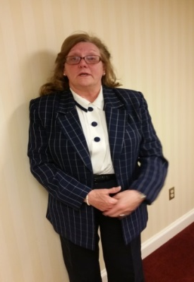
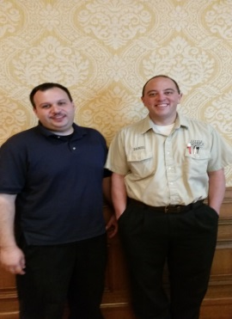
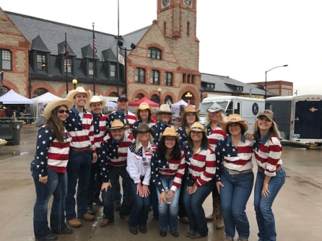
Meet the Cheyenne Management Team

Slide 9
Benefits
Insurance
401 K
Paid Time Off
R&R
Employee Discounts
Employee Cafeteria
FMLA
Funeral Leave
Tuition assistance
Questions
Notes:
Little America and Sinclair Services Company strives to provide excellent employee benefits at a minimal cost to the employee. Employees who work an average of 32 or more hours per week are eligible for the following benefits:
Medical, Dental and Vision insurance beginning the first day of the month following 60 days of continuous full time employment. The employee must enroll or decline within 31 days of eligibility or lose eligibility for coverage. It is your responsibility to enroll; you will be given information about our insurance plan in approximately 45 days. All employees are automatically given a $20,000 life insurance policy at no cost to them. However, you must complete information regarding your beneficiary. Employees also have the option of establishing a flexible spending account with pre tax dollars. Employees are given sick and vacation time after one year of service. Vacation time cannot be carried over from year to year, but sick leave can. After one year of service, Memorial Day, Independence Day and Labor Day are paid holidays. New Year’s Day, Thanksgiving Day, and Christmas Day are not paid, if not worked. If you work one of these three holidays you are paid at one and one half times your regular wage.
Employees are eligible for discounts at other Little America properties and may also apply for a Sinclair card, which affords a 5% discount on all purchases. We also offer a discount if you buy fuel at the Travel Center. Currently the discount is 15%. See the HR manager for additional information. The employee cafeteria provides meals for staff at a cost of $2.00, which is deducted from your paycheck. You will use your identification card to clock in and out each shift, and to purchase meals in the employee cafeteria. There is a $10.00 fee to replace lost cards.

Slide 10
Health and Safety
Wellness/smoking policy
Workers Compensation
Evacuation Plans
Questions

Slide 11
Departmental Policies and Procedures
Chain of Command/reporting structure
Parking
Cell phone use
Timekeeping
Attendance
Uniforms
Performance Evaluations
Driver Consent
Questions

Slide 12
? ? ? Around the Room ? ? ?
What is one thing that has stuck with you so far today?
What is a burning question you still have about the onboarding process?

Slide 13
Now…to get Manager Buy In

Slide 14
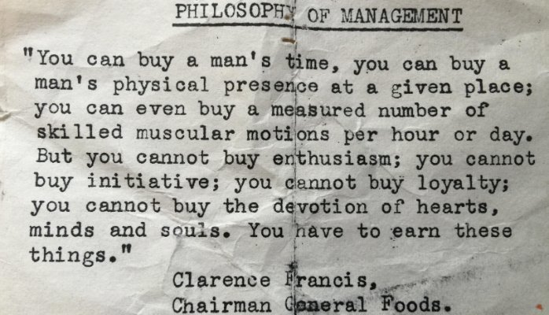

Slide 15
Some statistics
Bamboo HR (2014) average company loses 1 in 6 new hires each of the first three months
Aberdeen Group (2009) 54% of companies with onboarding programs reported higher employee engagement
SHRM (2010)the average cost to fill a position is between $300 and 18,000
OfficeTeam (2015) 40% of millennials want better onboarding

Slide 16
Plan Ahead for these Challenges
“We Don’t Have Time”
“That’s HR’s Job”
Who will train/what makes a good trainer
Short term vs long term

Slide 17
Article Debrief
Role Clarity
Manager Involvement
Navigating the Culture

Slide 18
Where do we go from here?
Welcome
Essential information Day One…what did you wish you knew your first day on the job?
By the end of the first week
What do they need to hear seven times?
What information should also be addressed during employee orientation?

Slide 19
THANK YOU
pfletcher@cheyenne.littleamerica.com
307-775-8485
Wyoming SHRM
Wyoming SHRM
@SHRMWY

